Slide 1


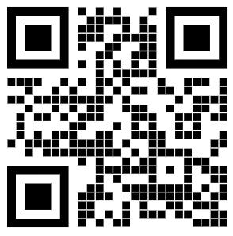
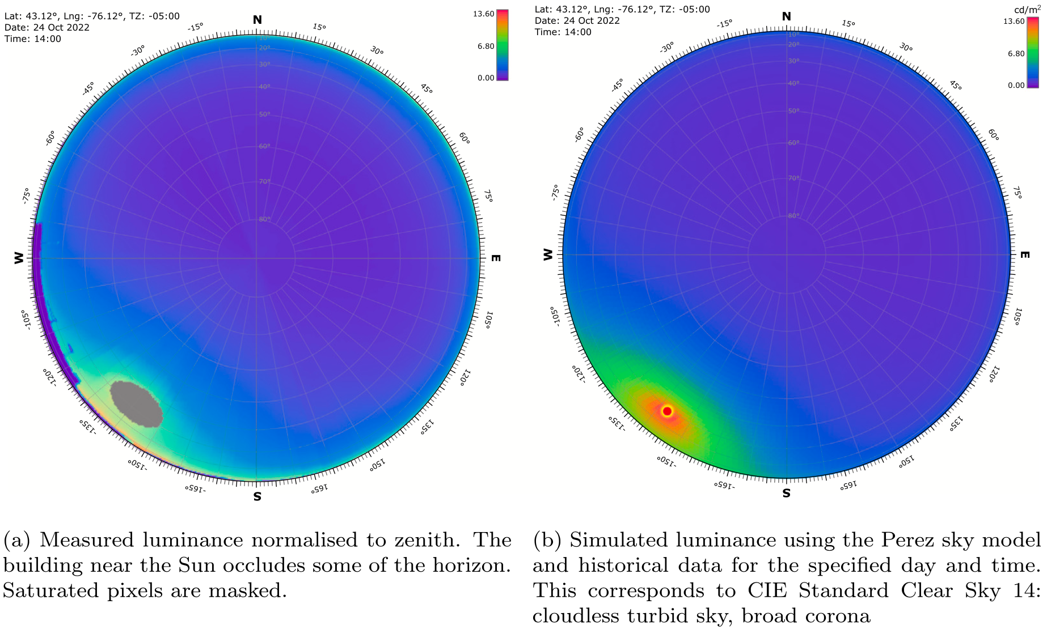
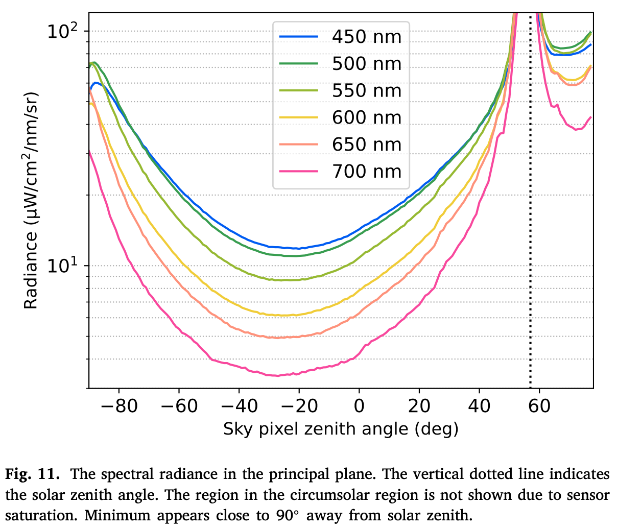
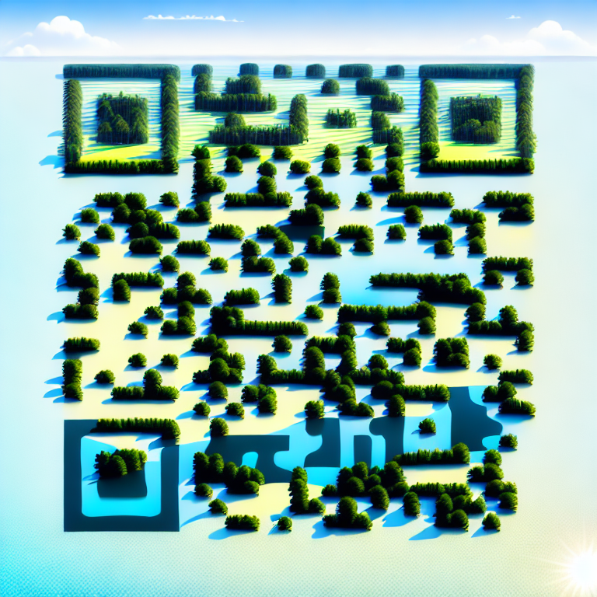
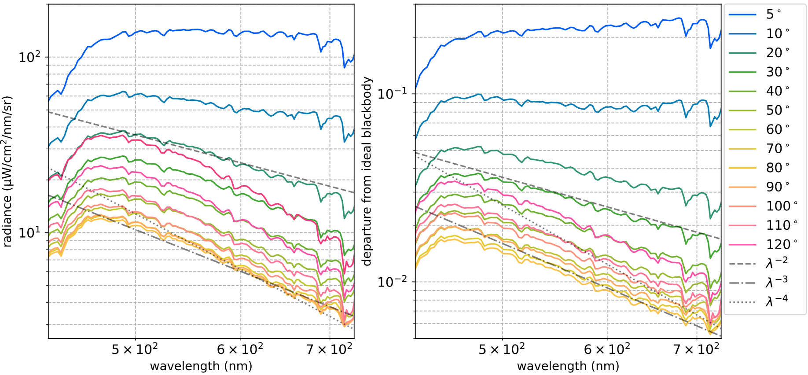

Measuring Diffuse Sky Radiance Using Imaging Spectroscopy
Yiwei Mao¹ Chris H. Lee² Charles M. Bachmann² Bradley J. Evans³ Iver H. Cairns¹
¹University of Sydney ²Rochester Institute of Technology ³University of New England
Imaging Spectrometer
Stats, spectral range Pic of roof
Data Sphere
RGB Composite
Sky Models
Perez Luminance CIE standard sku
Experimental Design
roof
Principal Plane
roof
Further Resources and Links
References: Mao, Yiwei, et al. "Openhsi: A complete open-source hyperspectral imaging solution for everyone." Remote Sensing 14.9 (2022): 2244. Mao, Yiwei, et al. "A Customisable Data Acquisition System for Open-Source Hyperspectral Imaging." Sensors 23.20 (2023): 8622. Mao, Yiwei, et al. "High resolution imaging spectroscopy of the sky." Solar Energy 262 (2023): 111821
https://www.openhsi.github.io
AGU Fall Meeting 2023, San Francisco 11-15 December 2023, Session A41S
yiwei.mao@sydney.edu.au

Slide 2

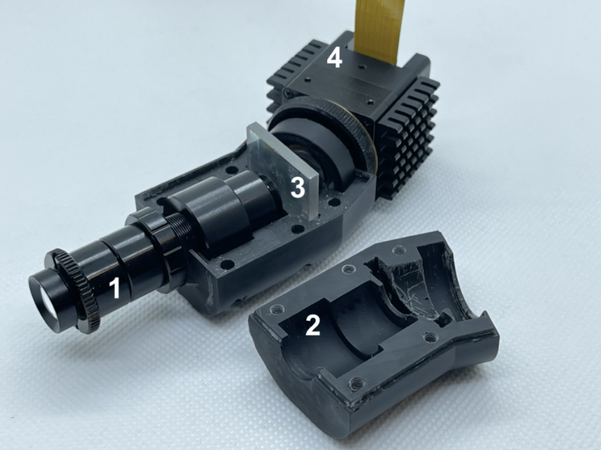
Open-source Imaging Spectroscopy for the Remote Sensing Practitioner
Yiwei Mao¹ Christopher H. Betters¹ Samuel Garske¹ Sergio Leon-saval¹ Iver H. Cairns¹ Bradley J. Evans²
¹University of Sydney ²University of New England
Open-source & Collaboration
Github
Software & Documentation
Camera API Calibration Install guide, tutorials
Hardware Design
Pushbroom stats
Data Acquisition System
Open-source
Further Resources and Links
References: Mao, Yiwei, et al. "Openhsi: A complete open-source hyperspectral imaging solution for everyone." Remote Sensing 14.9 (2022): 2244. Mao, Yiwei, et al. "A Customisable Data Acquisition System for Open-Source Hyperspectral Imaging." Sensors 23.20 (2023): 8622. Mao, Yiwei, et al. "High resolution imaging spectroscopy of the sky." Solar Energy 262 (2023): 111821
Remote Sensing
Drone Atmos Georeferencing
https://www.openhsi.github.io
AGU Fall Meeting 2023, San Francisco 11-15 December 2023, Session IN13D
yiwei.mao@sydney.edu.au

Slide 3
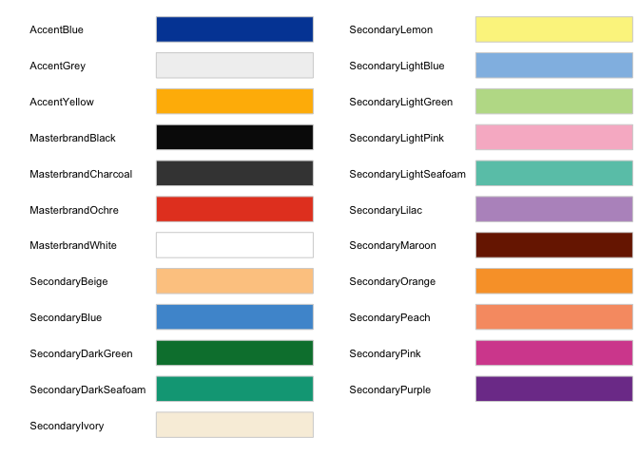
colourName R G B hex
AccentBlue 1 72 164 #0148A4
AccentGrey 241 241 241 #F1F1F1
AccentYellow 255 184 0 #FFB800
MasterbrandBlack 10 10 10 #0A0A0A
MasterbrandCharcoal 66 66 66 #424242
MasterbrandOchre 230 70 38 #E64626
MasterbrandWhite 255 255 255 #FFFFFF
SecondaryBeige 253 202 144 #FDCA90
SecondaryBlue 78 152 211 #4E98D3
SecondaryDarkGreen 0 126 59 #007E3B
SecondaryDarkSeafoam 0 164 133 #00A485
SecondaryIvory 248 239 221 #F8EFDD
SecondaryLemon 251 243 141 #FBF38D
SecondaryLightBlue 145 189 229 #91BDE5
SecondaryLightGreen 189 220 150 #BDDC96
SecondaryLightPink 248 185 204 #F8B9CC
SecondaryLightSeafoam 104 198 182 #68C6B6
SecondaryLilac 184 150 198 #B896C6
SecondaryMaroon 122 32 0 #7A2000
SecondaryOrange 249 161 52 #F9A134
SecondaryPeach 247 156 114 #F79C72
SecondaryPink 214 81 157 #D6519D
SecondaryPurple 127 63 152 #7F3F98

Slide 4
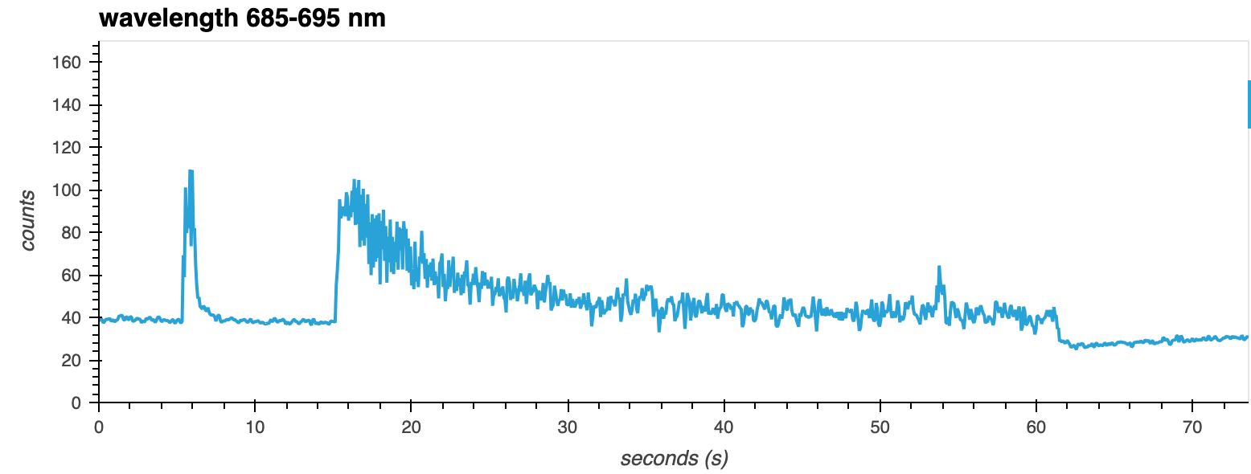
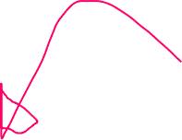



Saturating beam
Actinic light on
Saturating beam
Actinic light off

